Slide 1
Mass Shooting and Gun purchases in U.S.A
Project 1
Danelle, Ali, BrIAn & TiM

Slide 2
Research question
Do gun sales increase after a major mass shooting?
Hypothesis: Gun sales do increase after a major mass shooting
Null Hypothesis: Gun sales do not increase after a major mass shooting

Slide 3
Data sources
Mother Jones A Guide to Mass Shootings in America https://www.motherjones.com/politics/2012/07/mass-shootings-map/
Mother Jones created an open source database documenting mass shootings
Using data from 2014 through July 2019

Slide 4
Data sources
Gun Violence Archive https://www.gunviolencearchive.org/reports
Gun Violence Archive (GVA) is a not for profit corporation formed in 2013 to provide free online public access to accurate information about gun-related violence in the United States.
GVA collects and checks for accuracy, comprehensive information about gun-related violence in the U.S. and then post and disseminate it online.
Using data from 2014 through July 2019

Slide 5
Data sources
National Instant Criminal Background Check System (NICS) https://www.fbi.gov/services/cjis/nics
We are using this as a proxy for looking at gun sales
Data are recorded for each state by month and year
Using the data from 2014 through July 2019

Slide 6
Data sources
Google Trends https://trends.google.com/trends/?geo=US
We looked at data pertaining to the search term “shooting”
We used data from 2014 through July 2019

Slide 7
Data sources
Twitter API
We successfully obtained a Twitter API but were unable to use the data in our analysis

Slide 8
Definitions
For our study we defined mass shooting as:
Shooting where 5 or more people were injured or killed
It was not a gang shooting
It coincided with a high number of google searches on “shootings”
Google trends creates a scaled score (0-100) for a search term (Relative Value)
Data points are divided by the total searches of the geography and time range it represents to get a better representation of relative popularity of a search term at a given time point.
During the search period (Jan 2014 – July 2019) shooting received a search values:
Range : 18 and 100
Mean: 30.31 (SD: 15.05)
We used data with a score that was ½ of a standard deviation below the mean to determine if the shooting period caught national attention (approx. 23 Relative Value)

Slide 9
definitions
For our study we used FBI background check data to represent gun purchase data.
We included the number of successful purchases of handguns, long-guns, other guns, and multiple weapons as gun purchases per month

Slide 10
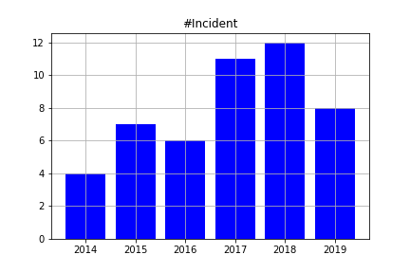
Mass shooting data

Slide 11
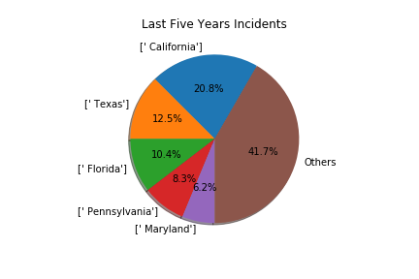
Mass shooting data

Slide 12
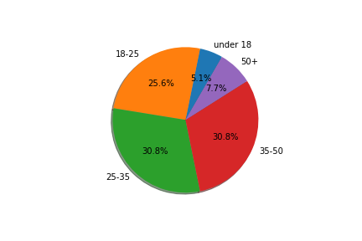
Mass shooting data

Slide 13
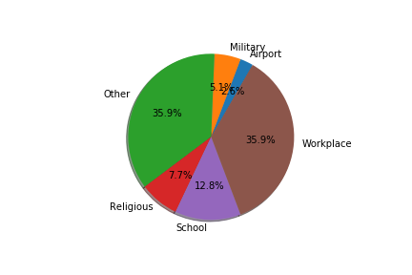
Mass shooting data

Slide 14
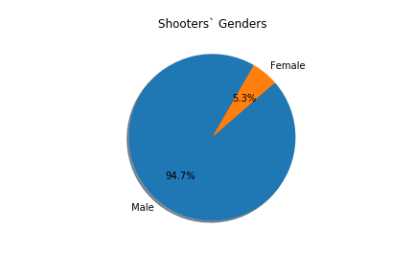
Mass shooter data

Slide 15
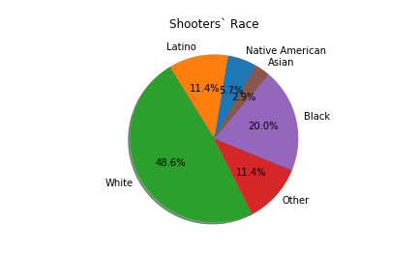
Mass shooter Data

Slide 16
Mass shooting data Used in ttest
Total: 28 Shootings met our criteria for analysis from Jan 2014 through July 2019
Mean Number of Shootings per Year: 4.67 (SD: 1.75)
Mean Number of Victims (injured or killed) per shooting: 41.39 (SD: 113.24)

Slide 17
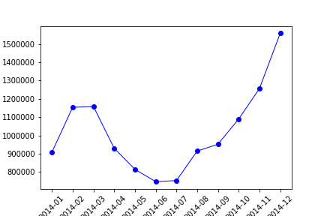
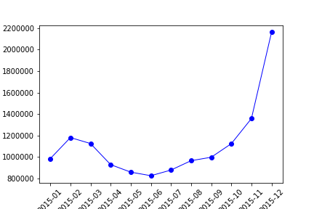
Gun sales data

Slide 18
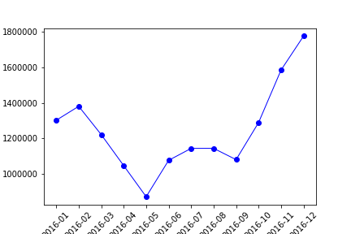
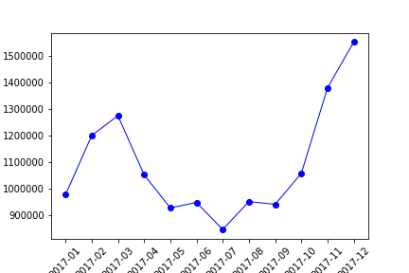
Gun sales data

Slide 19
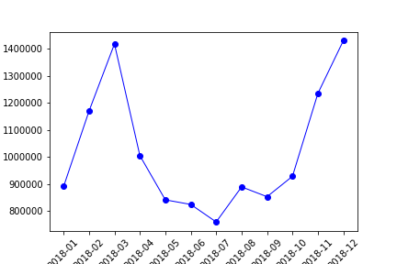
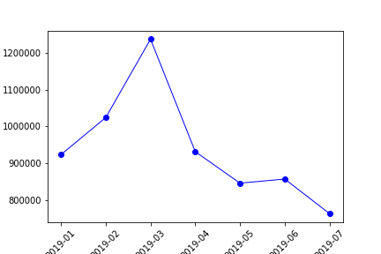
Gun sales data

Slide 20
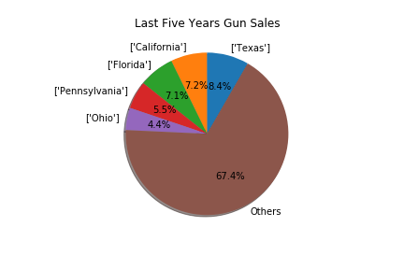
Gun sales data

Slide 21
Gun sales data
Jan- 2014- July 2019
Total Gun Sales: 72,463,764
Gun Sales per Month (M: 1,081,548.72; SD:262,654.64)

Slide 22
Methods
We used Pandas to clean and format our dataset(s)
Removed incidents with fewer than five victims
Removed incidents that occurred much earlier or later than the time frame
We created Incident IDs for all shootings and merged the data on these IDs to create and verify the incidences reported in the data sets.
We decided to use the Mother Jones data set primarily in our analysis because gave more information about the shootings
The Gun Violence Archive data was useful as a method of verifying the shooting information
The Gun Violence Archive also contained gang shootings with a large number of victims (this did not meet our definition.

Slide 23
Methods
We created a numeric variable called “monthyr_num” through which we can linked the data from the gun sales data set, the google trends data, and the Mother Jones mass shooting data
We created a “monthyr_impact” variable to use to merge in the total guns purchased the month after a major mass shooting. The monthyr_impact variable was created through adding one month to the monthyr_num variable

Slide 24
Methods
We created a “monthyr_prev” variable to use to merge in the total guns purchased data for the same period the year before the shooting. This variable was created by subtracting one year from the monthyr_impact variable.
We used the total number of guns purchased during these periods to look at the difference in the number of guns purchased just after a mass shooting and the number of guns purchased normally at during that same month

Slide 25
Methods
We examined the data from these data sets and looked for discernable patterns between gun sales and mass shootings.
We ran an independent sample t-test to look at the difference between the mean number of guns purchased in months not directly following a mass shooting and the mean number of guns purchased in the months directly following a major mass shooting.
We looked at stock patterns for Smith & Wesson and Ruger (RGR) surrounding the time the Las Vegas shooting, the highest profile mass shooting in the United States.

Slide 26
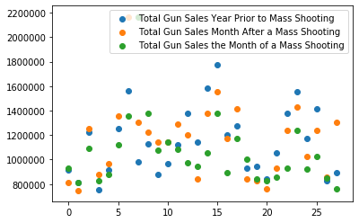
Gun sales scatter plot

Slide 27
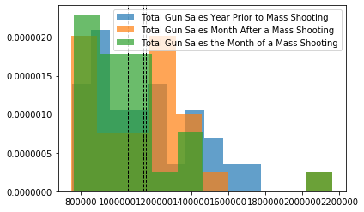
Gun Sales Histogram

Slide 28
Results
T-test
There was not a significant difference in the number of guns purchased just after a mass shooting (M=1153004.15, SD=304920.32) and the number of guns purchased at the same time of year when there was no mass shooting (M=1138564.50, SD=272338.34) ; t(1.262), p=.0.212.

Slide 29
Pearson Correlations Between Variables | Number of Mass Shootings | Total Number of Victims | Relative Value (Google Search) | Total Gun Sales Without Mass Shooting | Total Gun Sales Month After Mass Shooting | Total Gun Sales During the Month of a Mass Shooting
Number of Mass Shootings | 1.0 | .30 | .20 | .19 | -.02 | .06
Tot Num Vict | .30 | 1.0 | .70** | .33 | .18 | .06
Relative Val (Google) | .20 | .70** | 1.0 | .23 | .25 | .27
Total Gun Sale W/O Mas Shoot | .19 | .33 | .23 | 1.0 | .74** | .33
Total Gus Sale After Mass Shoot | -.02 | .18 | .25 | .74** | 1.0 | .54**
Total Gun Sale Same Month | .06 | .06 | .27 | .33 | .54** | 1.0

Slide 30
Conclusions
We could not find a statistically significant relationship between mass shootings and an increase in gun sales as compared to the sales the year prior during the time period we considered in this study.
We were not able to find any significant correlations between any of the data points we used.

Slide 31
Conclusions
Gun sales data appear to follow a fairly consistent pattern from year to year during the period we studied and do not appear to be significantly affected by the mass shootings that occurred in this period.
The strongest correlation was between gun sales after a mass shooting incident and gun sales during that time period the year before.

Slide 32
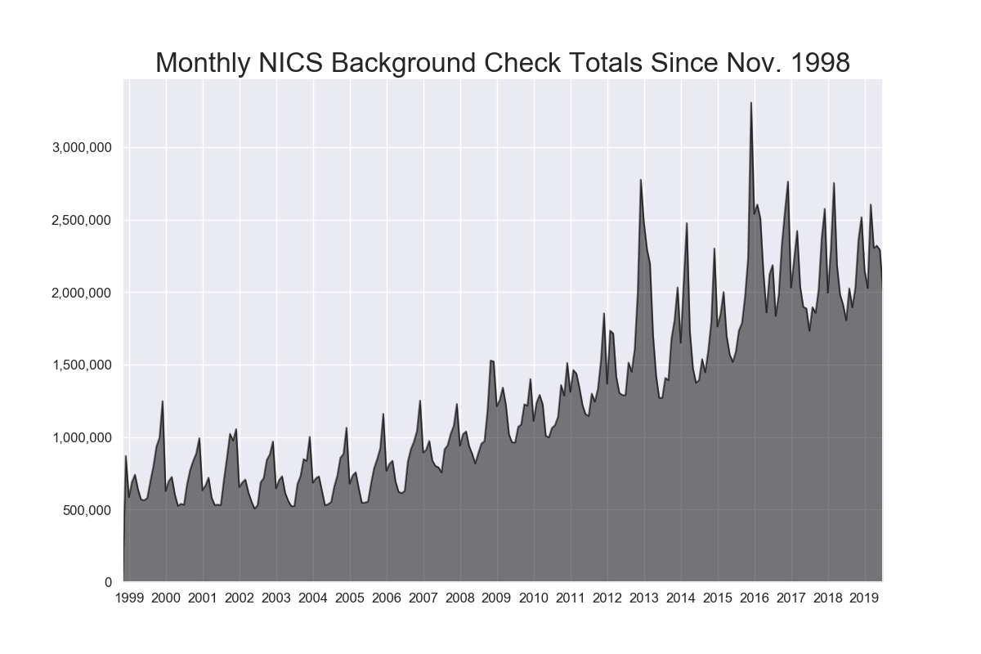
ANNUAL PATTERN

Slide 33
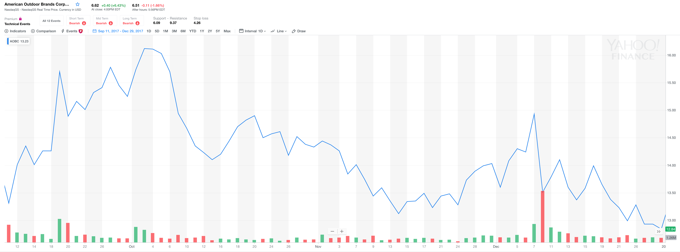
SMITH & WESSon
In looking at the data from the stocks market we were also not able to substantiate a significant relationship between mass shootings and firearm stock increases.

Slide 34
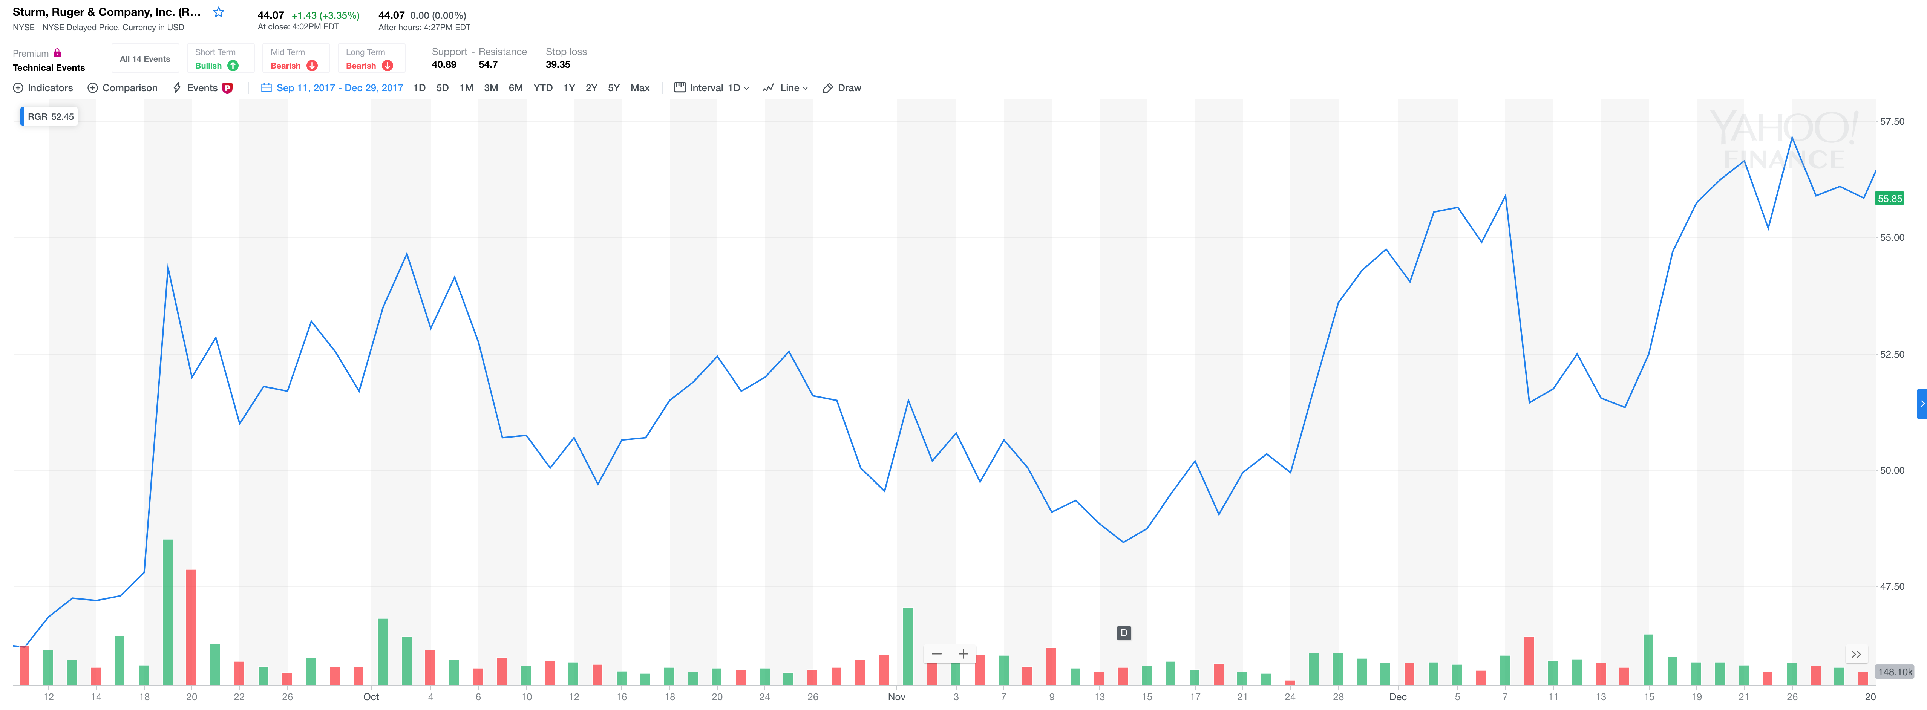
Ruger
In looking at the data from the stocks market we were also not able to substantiate a significant relationship between mass shootings and firearm stock increases.

Slide 35
Limitations
We used a very narrow definition of mass shooting (5 or more people shot or killed and corresponds with a high rate of searches for “shooting” on google trends)
A broader definition would have allowed for more data point
We limited our study to five years.
We may have been able to detect more minute changes in the pattern if we had a longer span of time

Slide 36
Limitations
We used the FBI data from background checks to look at gun purchases.
This data may not included all gun sales and is unlikely to include person to person gun sales or gun sales at gun shows
We used a T-test to compare mean sales between two time periods
Other statistical methods would have allowed for a more complex understanding of the relationship between mass shootings and gun violence.
We did not account for legislation restricting gun sales or political debates surrounding gun sale restrictions

